Slide 1
微机原理与接口技术
Theory and Interface Technology of Microcomputer
北京化工大学
信息科学与技术学院
主讲教师： 郭青
guoqing@mail.buct.edu.cn

Slide 2
Chapter 2
Instruction Set

Slide 3
2.1 Addressing Modes
寻址方式
Objective
Explain the operation of each addressing mode
Use the addressing modes to form assembly language statements
Select the appropriate addressing mode to accomplish a given task

Slide 4
Real Mode Memory Addressing
Real mode memory addressing 实地址方式 8086及以上
Protected mode memory addressing 保护虚地址方式
80286 and above
Real mode operation allows the microprocessor to address only the first 1M byte of memory space.
20-bits address
A combination of a segment address and an offset access a memory location in the real mode.
实地址模式下，1M的存储空间分为若干个逻辑段，使用段地址及偏移地址进行访问。

Slide 5
2.1.1 Segments and Offsets
Segment — 64K-byte memory 逻辑段
Real address — 20-bits 实地址
Segment address — 16-bits 段地址
Internally appended a 0H on its rightmost end. Located within one of the segment registers, defines the beginning address of any 64K-byte memory segment.
16位段寄存器存放20位段首地址的高16位
Offset address — 16-bits 偏移地址
Selects any location within the 64K byte memory segment.

Slide 6
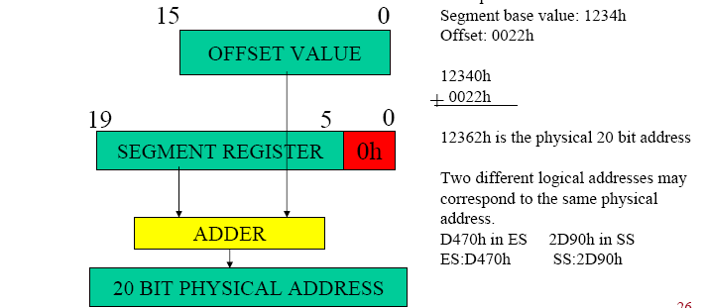
Logical and Physical Addresses
Physical Address is the real 20-bits address 物理地址
Logical address is expressed by 16-bits segment address and 16-bits offset address 逻辑地址
example: 1234H : 0022H

Slide 7
The Range of Segment
Segment — 64K-byte memory
Offset address — 16-bits from 0000H ～ FFFFH
The lower range of the segment (the minimum physical address) is
segment address×10H + 0000H
The upper range of the segment (the maximum physical address) is
segment address×10H + FFFFH

Slide 8
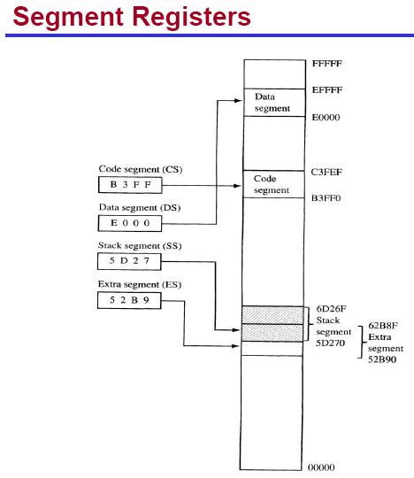
Segments in 8086/8088
8086/8088
Code segment
Data segment
Stack Segment
Extra Segment

Slide 9
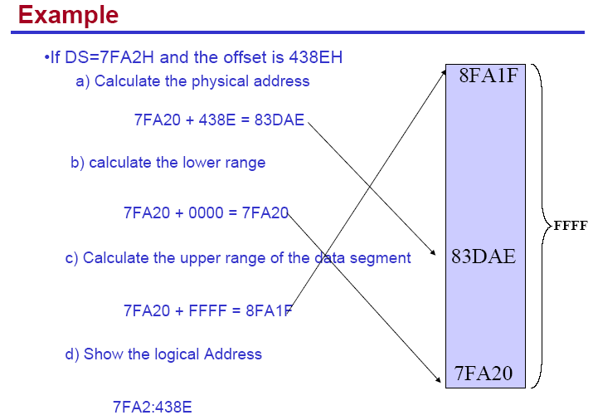

Slide 10
Default Segment and Offset Registers
Segment | Offset | Special Purpose
CS | IP | Instruction address
SS | SP or BP | Stack address
DS | BX, DI, SI, an 8-bits number, or a 16-bits number | Data address
ES | DI for string instructions | String destination address
CS:IP always address the next instruction in a program
指向下一条要执行的指令
For example, (CS) = 1400H, (IP) = 1200H
i.e. logical address 1400H : 1200H
Physical address CS×10H + 1200H = 15200H
Memory location of next instruction

Slide 11
2.1.2 Data Store in Memory
Byte-sized Data
One byte of memory, 8-bits
Word-sized Data
Two bytes of memory, 16-bits
字或者双字数据在存储器中的存放原则：
低位字节存放在低地址单元（地址较小的存储单元），高位字节存放在高地址单元
Doubleword-sized Data
Four bytes of memory, 32-bits
The least significant byte is stored in the lowest-numbered memory location, and the most significant byte is stored in the highest-numbered memory location

Slide 12
Data Store in Memory
Example：Store following three data in the memory
1) 12H in memory location of 3000H
2) 1020H in memory location of 3002H
3) 3456789AH in memory location of 3004H
2FFFH
3000H
3001H
3002H
3003H
3004H
3005H
3006H
3007H
3008H
12H
20H
10H
9AH
78H
56H
34H

Slide 13
2.1.3 Data-addressing Modes
数据的寻址方式
Machine language（机器语言）is the native binary code that the processor understands and uses as instructions to control its operation.
an instruction（指令） is a single operation of a processor defined by an instruction set.
指令是计算机规定的基本操作命令；所有指令的集合称为指令系统。
The opcode, or operation code (操作码)selects the operation that is performed by the microprocessor。
操作码表示指令操作的性质。
机器指令格式
操作码字段
地址码字段

Slide 14
2.1.3 Data-addressing Modes
机器指令格式
操作码字段
地址码字段
When the 8088/86 executes an instruction, it performs the specified function on data, These data, called operands, 操作数 操作数是指令操作的对象
–May be a part of the instruction 指令的一部分
–May reside in one of the internal registers of the microprocessor 存放在寄存器中
–May be stored at an address in memory 存储单元中
Addressing modes tell us how to locate the operands.
指明操作数或者操作数的地址

Slide 15
MOV Instruction
opcode
Operands
MOV AX, BX
Destination
目标操作数
Source
源操作数
usually change
never change
The MOV instruction transfers bytes or words of data between registers, or between registers and memory in the 8086
, or <number>

Slide 16
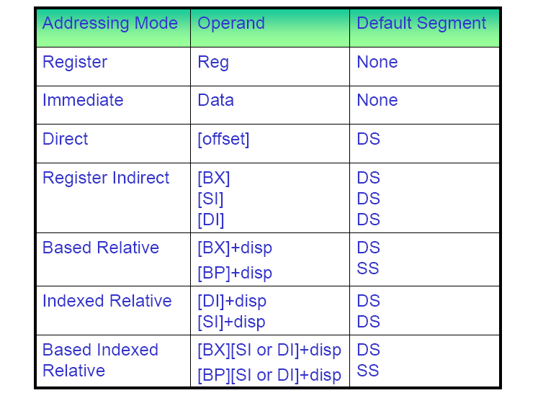
Summary of Data-addressing Modes
[BP]
SS

Slide 17
1. Register Addressing 寄存器寻址
Most common, the operand is in the register
8-bits
AH, AL
BH, BL
CH, CL
DH, DL
16-bits
AX
BX
CX
DX
SP, BP
SI, DI
CS, ES, DS, SS
FS, GS
32-bits
EAX
EBX
ECX
EDX
ESP, EBP
ESI, EDI
80386 and above

Slide 18
Example MOV AX, BX
AX
BX
Assume (AX) = 1010 0101 B, (BX) = 0110 1001 B
AX
BX
1010 0101
0110 1001
MOV AX, BX
AX
BX
不变
0110 1001
0110 1001

Slide 19
Note：
The source and destination registers are the same size. 必须同时为字节或者字数据
MOV AL, BL
MOV SP, BP Right
MOV ECX, EBX
MOV AX, BL
MOV AX, AL ERROR
MOV EAX, BX

Slide 20
2. Immediate Addressing 立即寻址
Immediate implies that the data immediately follow the opcode in the memory.
Immediate data are constant data 常数
Example: MOV AX, 1234H
AX
0001 0010 0011 0100
立即数寻址，操作数直接放在指令中，紧跟在操作码的后面
操作数为常数，常用来为寄存器赋初值

Slide 21
3. Direct Addressing
The operand is a 16-bits memory location, located in the data segment.
Example: MOV AX, [3100H]
050FF
05100 | 10 H
05101 | 20 H
05102
DATA SEGMENT
DS
0200
×10H
+ 3100 H
Offset address
05100 H physical address
AX
?
直接寻址方式，地址码字段的16位数据为操作数的段内偏移地址，操作数的物理内存地址等于数据段段寄存器DS中的值左移4位后与16位偏移量之和。

Slide 22
3. Direct Addressing
The operand is a 16-bits offset address, located within the data segment.
Example: MOV AX, [3100H]
050FF
05100 | 10 H
05101 | 20 H
05102
DATA SEGMENT
DS
0200
×10H
+ 3100 H
address
05100 H memory
AX
2010
隐含的段寄存器为DS
也允许段超越，使用CS, SS或ES为段寄存器
例：MOV AX，ES：[3100H]

Slide 23
4. Register Indirect Addressing
寄存器间接寻址方式
The data is located in memory
Addressed through an offset address held in any of the following registers:
BX, BP, SI, DI
间址寄存器
Register Default Segment Register
BX, SI, DI
DS 默认的段寄存器
BP
SS

Slide 24
4. Register Indirect Addressing
Example:
MOV CX, [BX] 16-bits Data segment
MOV [BP], DL 8-bits Stack segment
MOV [DI], BH 8-bits Data segment
MOV [SI], BX 16-bits Data segment
Indirect Addressing often allows a program to refer to tabular data located in the memory system
适用于表格或数据块操作，允许段超越。

Slide 25
4. Register Indirect Addressing
Example:
Assume (DS)=1000H, (DI)=0500H and (AX)=12FEH
Show the memory locations after the execution of:
MOV [DI], AX
Physical address = DS×10H + DI = 10500H
物理地址
AX | 1 2 | F E
F E | 10500H
1 2 | 10501H

Slide 26
5. Indexed Relative Addressing
变址寻址
The data in a segment of memory are addressed by adding the displacement to the contents of an index register.
操作数在存储器中，地址是变址寄存器的内容加上偏移量
DI, SI
变址寄存器
Offset address = (DI or SI) + Disp
Displacement is 8-bits or 16-bits two’s complement
偏移量为16位或8位补码
MOV AL, [SI+10H]
MOV AX, [DI-1]
MOV AL, DATA[DI]
Default segment: DS

Slide 27
Example: MOV BX , [SI+1003H]
Assume (DS)=6000H ， (SI)=2200H
The source operand is indexed relative addressing.
Memory location is calculated as follows:
(DS)×10H+(SI)+1003H= ?
63203H
BH BL
63203H
63204H

Slide 28
6. Based-Relative Addressing
基址寻址
The data in a segment of memory are addressed by adding the displacement to the contents of a base register.
BP，BX
基址寄存器
Offset address = (BP or BX) + Disp
Default segment:
BP → SS
BX → DS
MOV [BX], AL
MOV AX, [BP-1]
MOV DL, DATA[BX]
有时将变址相对寻址和基址相对寻址合称为寄存器相对寻址

Slide 29
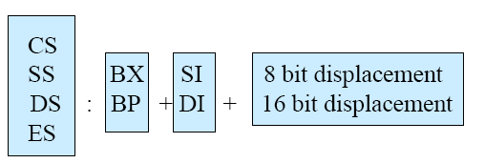
7. Based-Indexed Relative Addressing
Based Relative + Indexed Relative
Physical address
Default segment:
BP → SS
BX → DS
相对的基址加变址寻址方式
默认的段寄存器由基址寄存器决定。

Slide 30
7. Based-Indexed Relative Addressing
MOV AX, COUNT [BX][SI]
MOV AX, [BX+COUNT][SI]
MOV AX, [BX+SI+COUNT]
MOV AX, COUNT [SI] [BX]
等价
NOTE
MOV AX, COUNT [BX][BP]
MOV AX, [DI+SI+COUNT]
错误
不允许两个同时为基址寄存器或者变址寄存器

Slide 31
2.1.4 Program Memory-Addressing Modes
Direct
Relative
Indirect
程序转移的寻址方式
1. Direct program memory addressing 直接转移
The jump instruction for direct program memory addressing store the address with the opcode. 指令中直接给出转移地址
For example: JMP LABEL_FAR ; Address 10000H
machine | Opcode | Offset (low) | Offset (high) | Segment (low) | Segment (high)
language | EA | 00 | 00 | 00 | 10
 | 20000H | 20001H | 20002H | 20003H | 20004H
Next instruction: CS:IP = 1000H:0000H

Slide 32
2. Relative Program Memory Addressing
相对转移寻址方式
The term relative means
“relative to the instruction pointer (IP)”
Relative JMP and CALL instructions contain either an 8-bits or a 16-bits signed displacement. 指令给出8位或16位的补码，是转移目标地址相对于当前IP的偏移量
Provide intra-segment jump 段内转移
Example:
JMP [2]
10000 | EB
10001 | 02
10002 | —
10003 | —
10004
JMP [2]
10002 + 2
JMP LABEL

Slide 33
3. Indirect Program Memory Addressing
间接转移寻址方式
The indirect jump instructions use 16-bits register
AX, BX, CX, DX, SP, BP, DI, SI
Relative register
[BX], [BP], [DI], [SI]
Or relative register + displacement
Hold near offset address，intra-segment jump
Hold near offset address of memory location
which contains a 16-bits number used as the offset address in the intra-segment jump
or 32-bits segment and offset addresses for the intersegment jump.

Slide 34
Summary of Data-addressing Modes
[BP] SS

